Slide 1
Final presentation:
02/09/2020, Milano
Alessio Russo
Carmelo Valore

Slide 2
Dynamic bicycle model
Introduction /objectives
2
Alessio Russo, Carmelo Valore
Notes:
Inserire qui gli slip

Slide 3
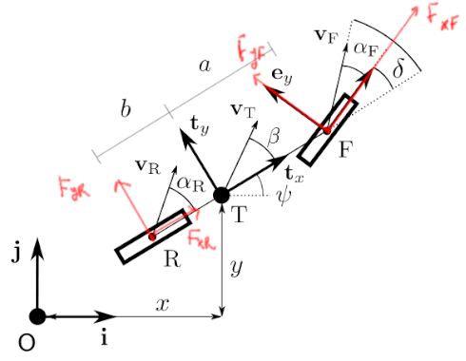
Dynamic bicycle model
Dynamic bicycle model
Pacejka tyre model
Aerodynamic forces
Fuel consumption model
Tyre wear model
Banking
Slipstream
3
Alessio Russo, Carmelo Valore
Notes:
Inserire qui gli slip

Slide 4
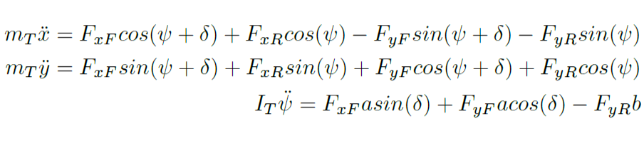
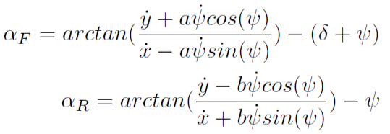
Dynamic bicycle model
Initial equations
Equilibrium with respect to the inertial frame Oij
4
Alessio Russo, Carmelo Valore
Notes:
Inserire qui gli slip

Slide 5
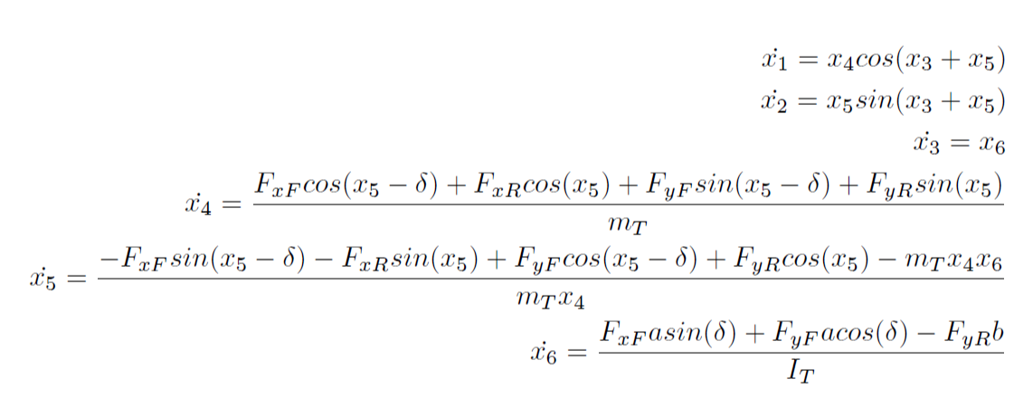
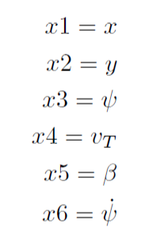
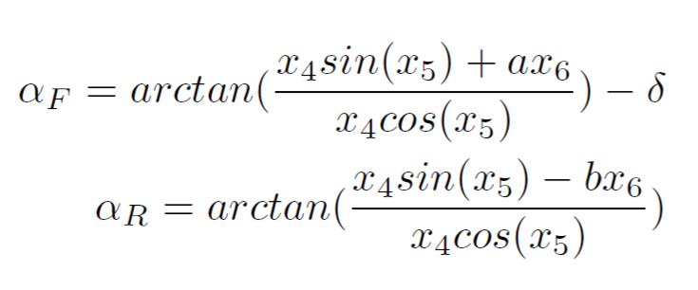
Dynamic bicycle model
We set the followings as the states of the model
So we derived the state equations
5
Alessio Russo, Carmelo Valore
Notes:
Inserire qui gli slip

Slide 6
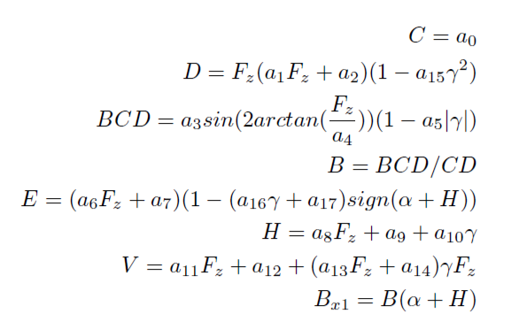
Pacejka tyre model
Pacejka formula derived
from experimental data
Takes as input:
the slip angle α
vertical load on the tyre F_{z}
the amplitude D
6
Alessio Russo, Carmelo Valore
Notes:
Inserire qui gli slip

Slide 7
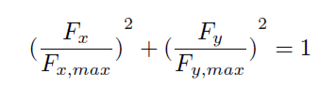
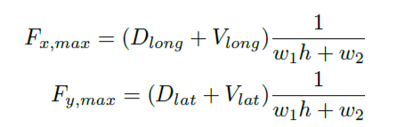
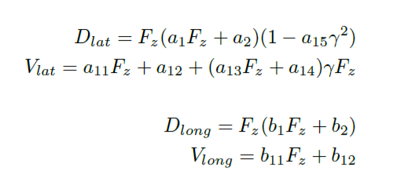
Friction ellipse (slide 1)
The physics of the tyre model is represented
through the friction ellipse
The ellipse dimension depends on:
the wear of the tyre h
the vertical load F_{z}
w₁ and w₂ that are parameters that regulate the scaling according to h
7
Alessio Russo, Carmelo Valore
Notes:
Inserire qui gli slip

Slide 8
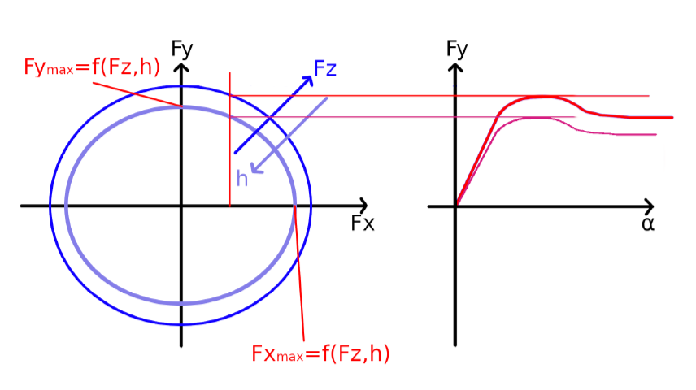
Friction ellipse (slide 2)
The control variable F_{x} determines F_{y} on the ellipse
The output of the Pacejka will be scaled according to F_{y}
We set the peak of the Pacejka (D_{lat} + V_{lat}) = F_{y}
8
Alessio Russo, Carmelo Valore
Notes:
Inserire qui gli slip

Slide 9
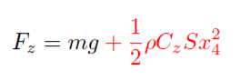
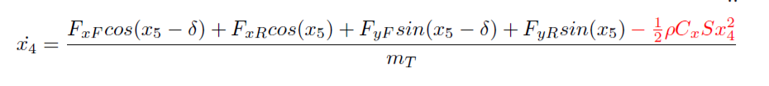
Aerodynamic forces
The drag force impacts on the body acceleration equation
Its contribution is negative because the applied force is opposite to the vehicle velocity
The contribution of the lift force increases the vertical load
Linear dependency with air density, drag/lift coefficient and area S of the considered surface. Square dependency with body velocity
9
Alessio Russo, Carmelo Valore
Notes:
Inserire qui gli slip

Slide 10
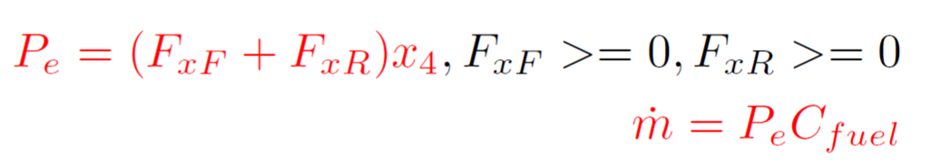
Fuel consumption model
Fuel consumption has been modelled by taking into account the power output
P = 0 while braking
P is multiplied by a C_{fuel} coefficient to express fuel consumption
10
Alessio Russo, Carmelo Valore
Notes:
Inserire qui gli slip

Slide 11
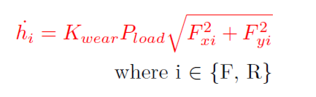
Tyre wear
Based on the Archard model for tyre wear
The model has been converted in order to take into account, instead of the sliding velocity, the forces acting on the wheels
So it depends on:
The vertical load pressure P_{load} = F_{z} / Tyre_contact_area
Forces F_{x} and F_{y} acting on the wheel
K_{wear} coefficient opportunely chosen
11
Alessio Russo, Carmelo Valore
Notes:
Inserire qui gli slip

Slide 12
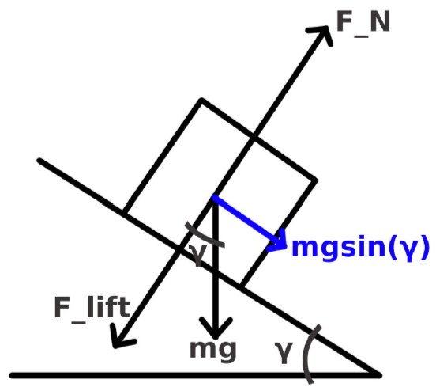
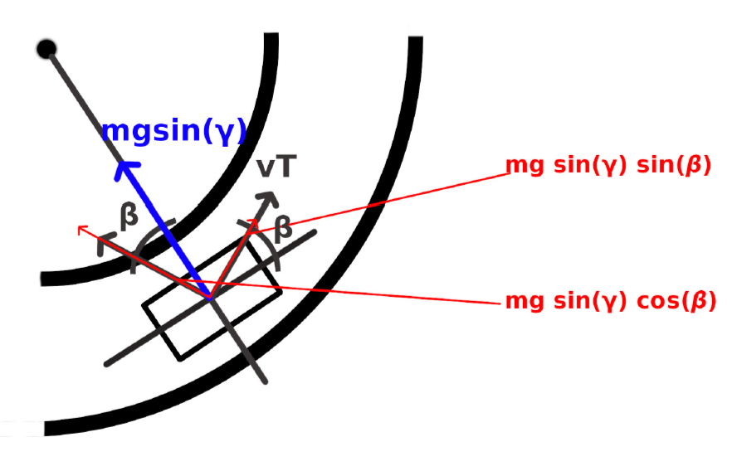
Banking (slide 1)
Banking has been considered in the model equations to take into acount the shape of Indianapolis circuit
To simplify the model, the car is assumed to always travel with in parallel with respect to the tangent of the curve. In this way we only consider the projection of the weight force along the road surface
Lateral view
Top view
12
Alessio Russo, Carmelo Valore
Notes:
Inserire qui gli slip

Slide 13
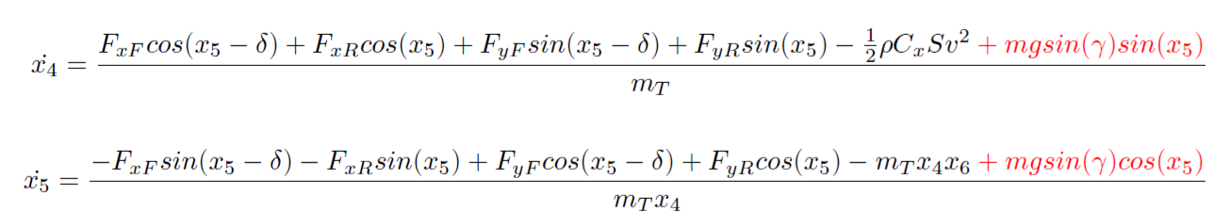
Banking (slide 2)
Given our assumptions, the projection mg*sin(γ) will
be directed to the center of the curve. Thus, we
projected it again to consider it into our state equations
13
Alessio Russo, Carmelo Valore
Notes:
Inserire qui gli slip

Slide 14
Slipstream
For slipstream different assumptions have been made to determine the change of aerodynamic coefficients
Different values conssidered if the vehicle is traversing straight paths or curvature paths
straight path: the drag force decrease is of 15% while the lift force decrease is of 30%
curvature path: the drag force decrease is of 15% while the lift forceis left unchanged
14
Alessio Russo, Carmelo Valore
Notes:
Inserire qui gli slip

Slide 15
Validation of the model
Some simulations have been run to test and validate the presented model
More details in the PDF
15
Alessio Russo, Carmelo Valore
Notes:
Inserire qui gli slip

Slide 16
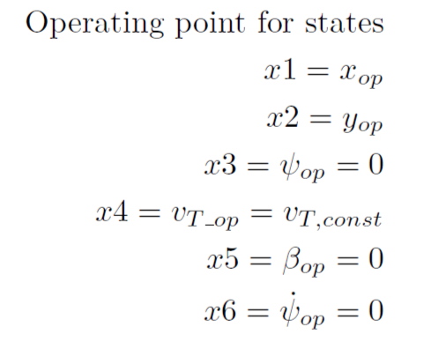
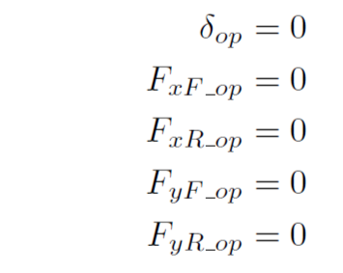
Control
To make the vehicle move according to a desired trajectory it is necessary to design a controller
We first need to linearize the model to design the controller on it
We choose as operating point for linearization a point where we assume that the vehicle is moving on a straight path with a constant longitudinal speed
On the right we can see the value of
states and inputs at the considered
operating point
16
Alessio Russo, Carmelo Valore

Slide 17
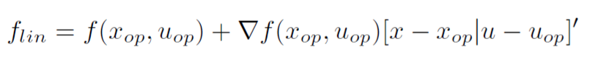
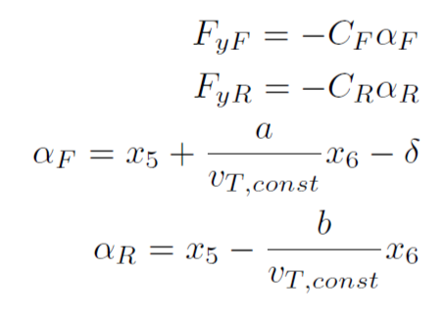
Control
Expanding the system in a Taylor series we have
Considering linear tyre model and linear version of the slip angles
17
Alessio Russo, Carmelo Valore

Slide 18
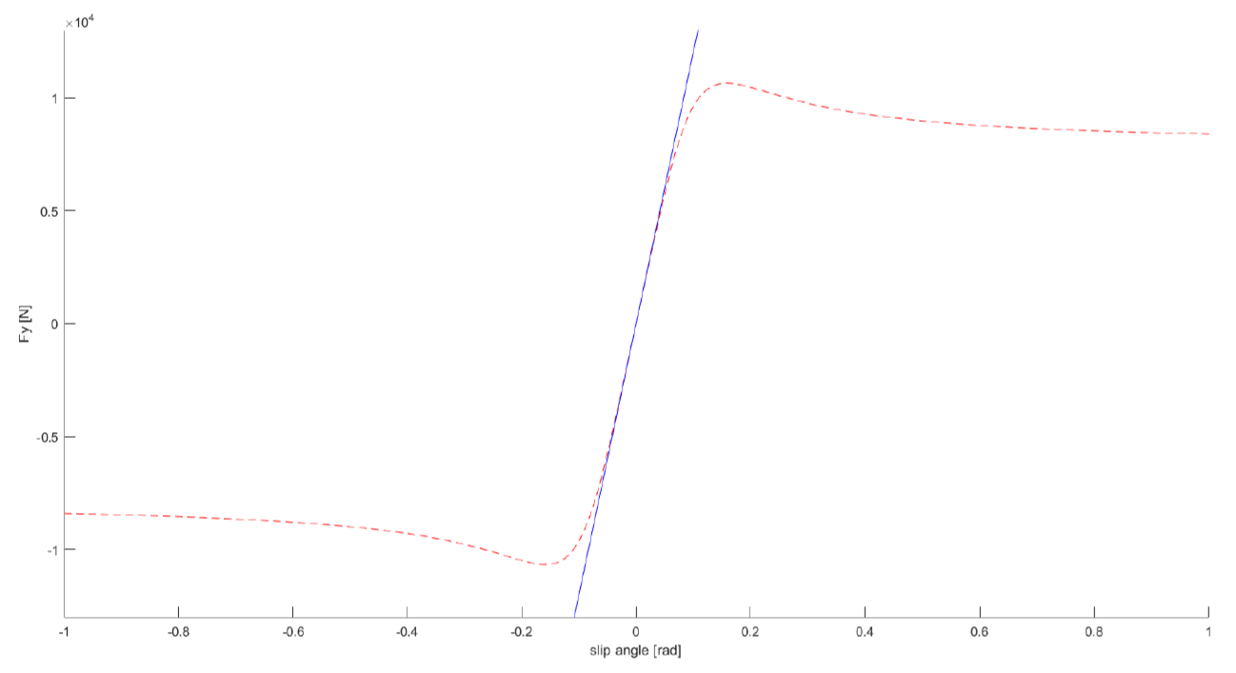
Control
The values for C_{F} and C_{R} have been chosen to best approximate the Pacejka tyre model in the case of small angles according to the mean vertical load on each wheel
18
Alessio Russo, Carmelo Valore

Slide 19
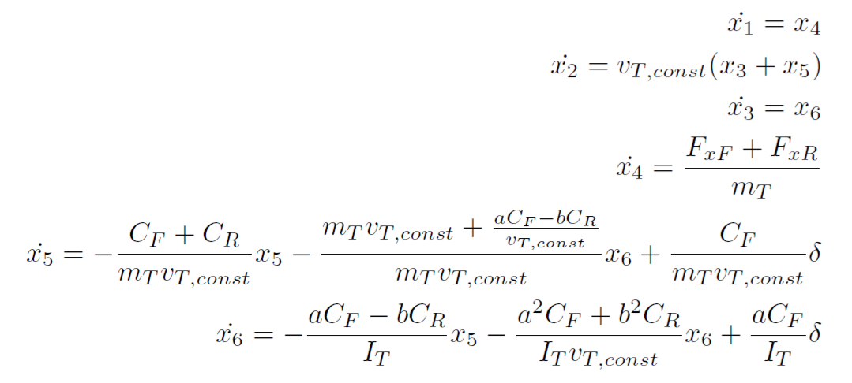
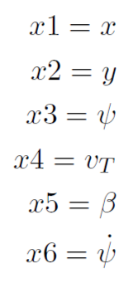
Control
So we obtain the linearized model
19
Alessio Russo, Carmelo Valore

Slide 20
Control
In our particular case it is possible to split the control logic into two independent controllers
Longitudinal controller: by controlling force on the rear wheel F_{xR} , it makes the vehicle follow a given velocity profile along the predefined trajectory
Lateral controller: by controlling the steering angle δ, it tries to minimize the lateral error with respect to a virtual point determined by the vehicle status and the lookahead distance
20
Alessio Russo, Carmelo Valore
Notes:
Inserire qui gli slip

Slide 21
Longitudinal control
The goal of the longitudinal controller is to make the vehicle follow a given speed profile
The speed profile is provided through an array of reference velocities indexed by the curvilinear abscissa
The reference velocity in a specific point of the track is found by looking up this array searching for the nearest point in the trajectory from the actual position of the vehicle
21
Alessio Russo, Carmelo Valore

Slide 22
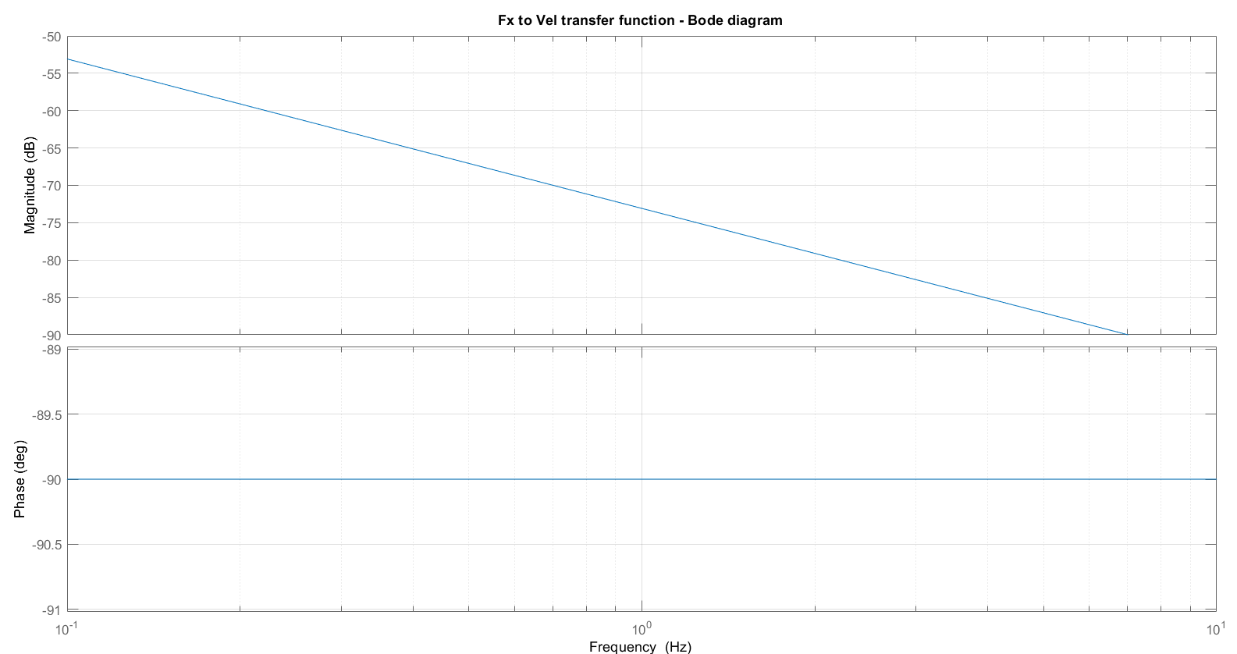
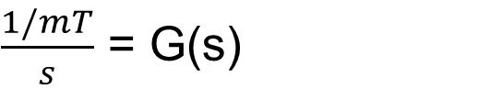
Longitudinal control
$\frac{1/mT}{s}$ = G(s)
Transfer function between Fx and vT:
22
Alessio Russo, Carmelo Valore

Slide 23
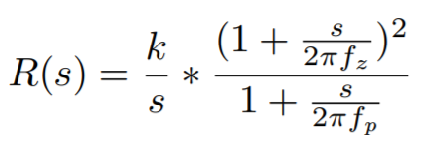
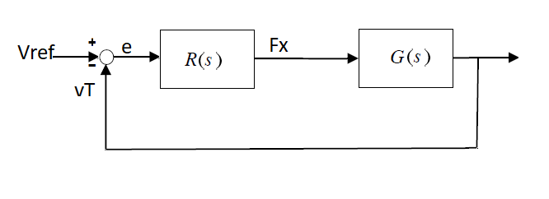
Longitudinal control
Regulator designed in order to:
- Obtain a bandwidth of at least 1 [Hz]
- have stable closed loop system
23
Alessio Russo, Carmelo Valore

Slide 24
Longitudinal control
Tuned parameters are:
f_{z} = 0.06 [Hz]
f_{p} = 0.03 [Hz]
k = 5.2 x 10³
The double zeros were chosen to be coincident for tuning simplicity and were added to obtain a raise of the phase margin thus the system to be stable. The pole at frequency f_{p} was added to obtain the desired bandwidth and to have a causal regulator.
24
Alessio Russo, Carmelo Valore

Slide 25
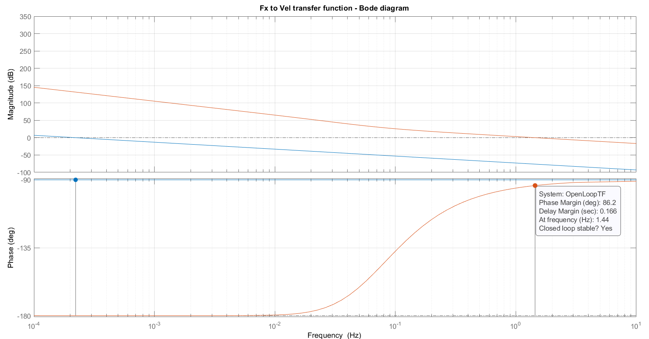
L(s) function Bode plot
25
Alessio Russo, Carmelo Valore

Slide 26
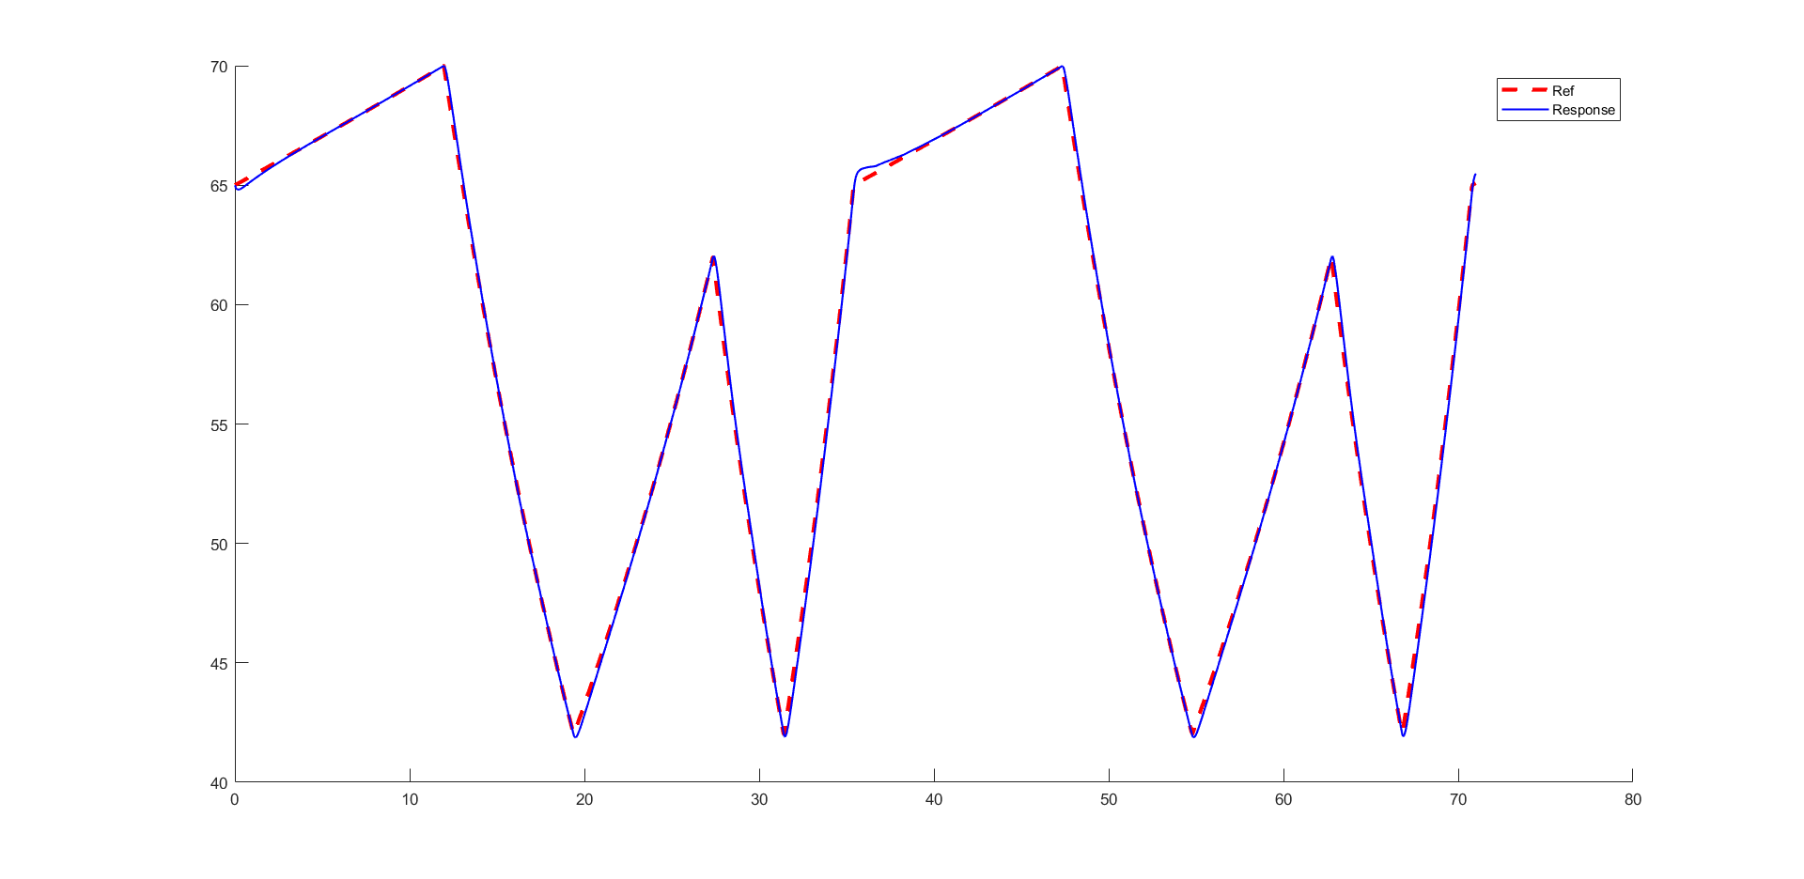
Longitudinal control
Results – deve essere cambiata:
26
Alessio Russo, Carmelo Valore

Slide 27
Lateral control
The goal of the lateral controller is to minimize the lateral error with respect to a virtual point determined by the vehicle’s position, vehicle’s heading direction and the lookahead distance
The idea behind the virtual point is to foresee where the car will be in the «next instant» and to steer accordingly in order to have a better path tracking
IMMAGINE NOSTRA DEL LOOKAHEAD DISTANCE
27
Alessio Russo, Carmelo Valore

Slide 28
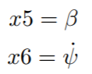
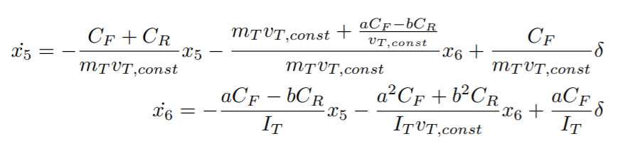
Lateral control
To build the lateral controller a slight modification in the considered state space model has been done
From the linearized model we first neglect the longitudinal dynamics and consider
28
Alessio Russo, Carmelo Valore

Slide 29
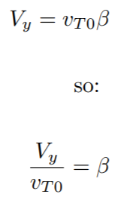
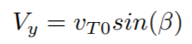
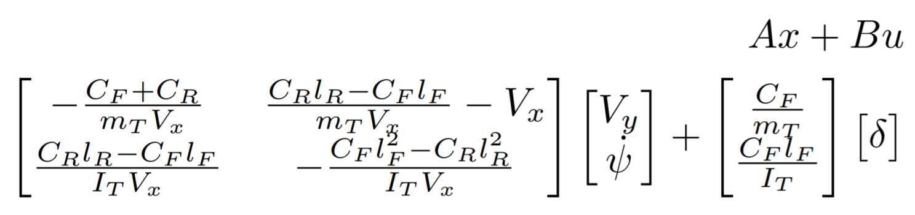
Lateral control
Then we make a change in the states by exploiting the following assumption that v_{T0} corresponds to V_{x} given that the vehicle is traversing a straight path and β is small
Thus obtaining
29
Alessio Russo, Carmelo Valore

Slide 30
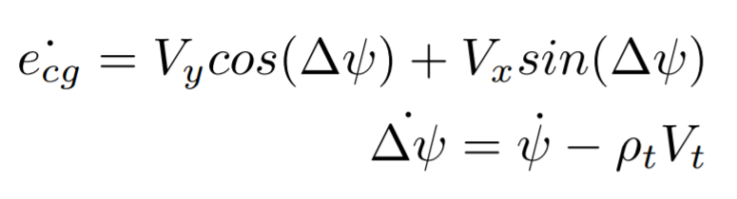
Lateral control
To this model two states and an input ρ (for the curvature) have been added to take into consideration the dynamic of the error
e_{cg} represents the lateral positioning error with respect to the center of gravity
∆ψ is the heading angle error, representing the difference between the desired yaw angle and the actual one
30
Alessio Russo, Carmelo Valore

Slide 31
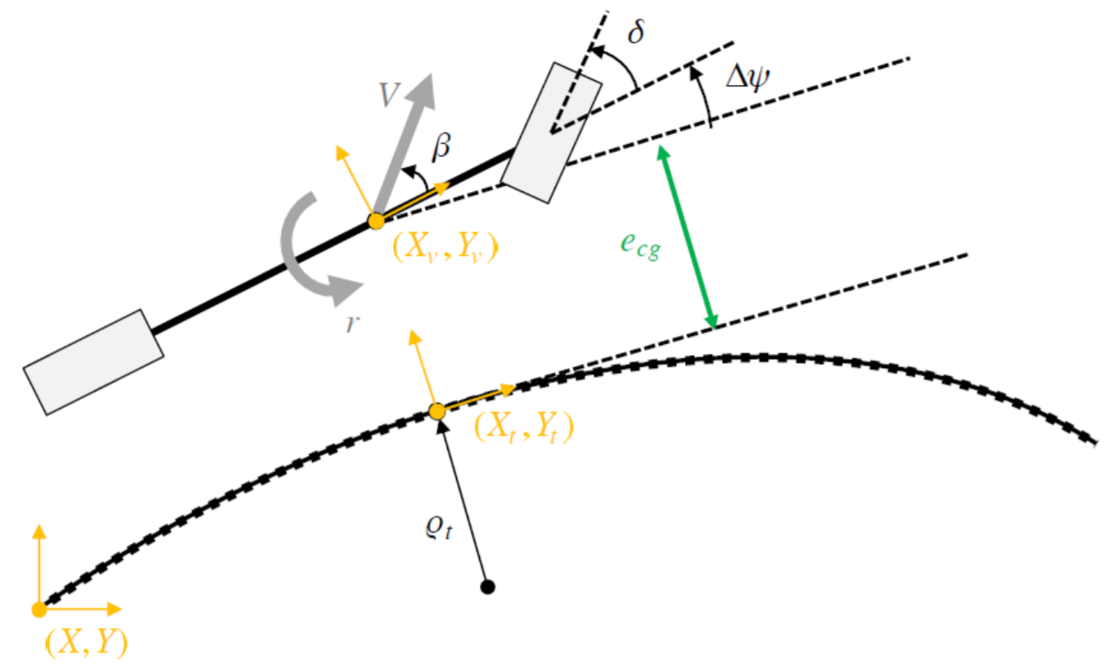
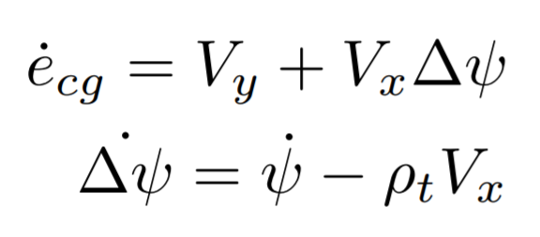
Lateral control
Using the small angle assumption and considering that the vehicle is well tracked we can also simplify
31
Alessio Russo, Carmelo Valore

Slide 32
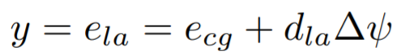
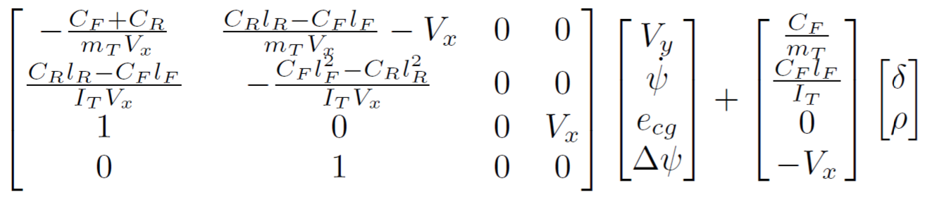
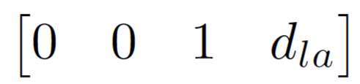
Lateral control
So the final error e_{la} will be the sum of e_{cg} and the error determined by the lookahead distance d_{la}
So we have the following as Ax + Bu
And C matrix =
32
Alessio Russo, Carmelo Valore

Slide 33
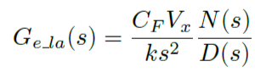
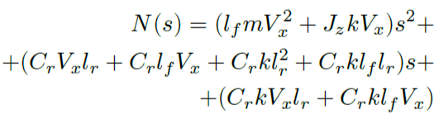
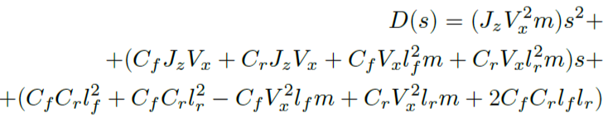
Lateral control
The transfer function obtained from the steering angle δ and the lateral error e_{la} error is
With N(s) and D(s):
33
Alessio Russo, Carmelo Valore

Slide 34
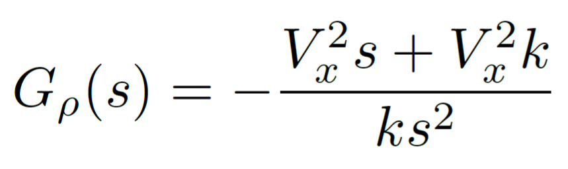
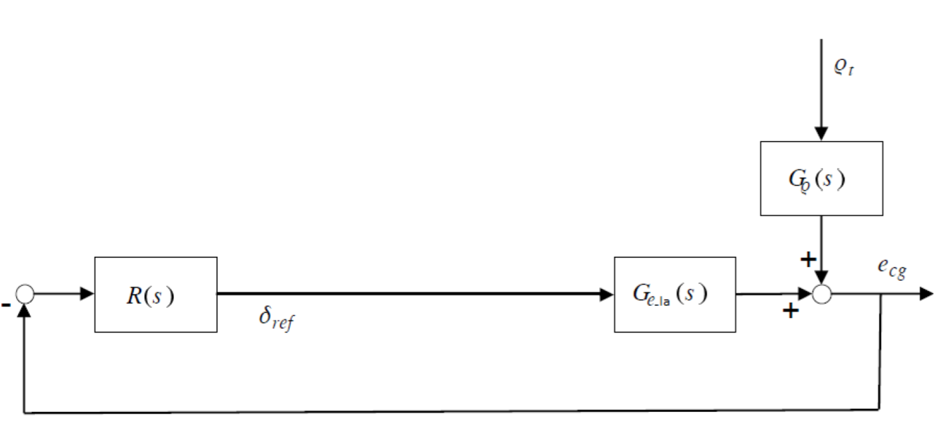
Lateral control
The transfer function obtained from the curvature ρ and the lateral error e_{la} error is
And the relative block diagram is:
34
Alessio Russo, Carmelo Valore

Slide 35
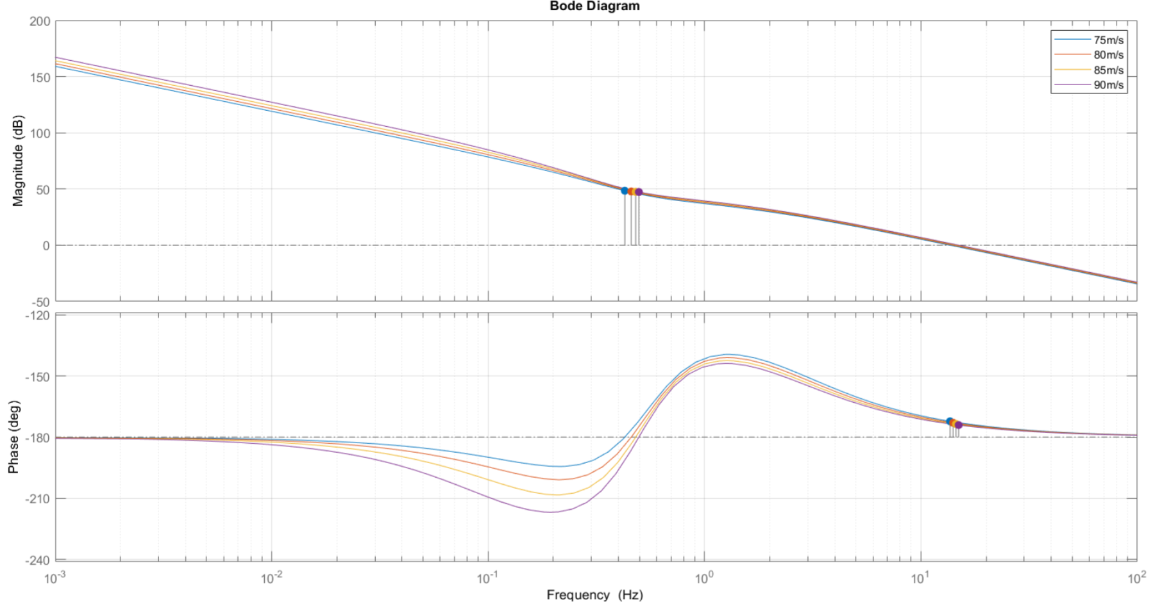
Bode plot of the plant G(s) at different velocities
35
Alessio Russo, Carmelo Valore

Slide 36
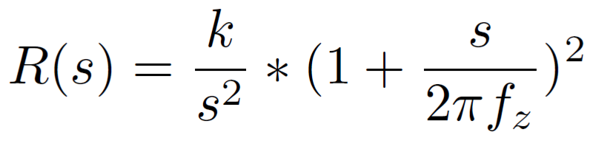
Lateral controller
Starting from the transfer function of the plant, the following regulator R(s) has been designed with tuned parameteres:
f_{z} = 0.01 [Hz]
f_{p} = 0.03 [Hz]
By combining R(s) and G(s) we obtain:
A closed-loop stable system
Rejects ramp disturbances
No need for rescheduling
36
Alessio Russo, Carmelo Valore

Slide 37
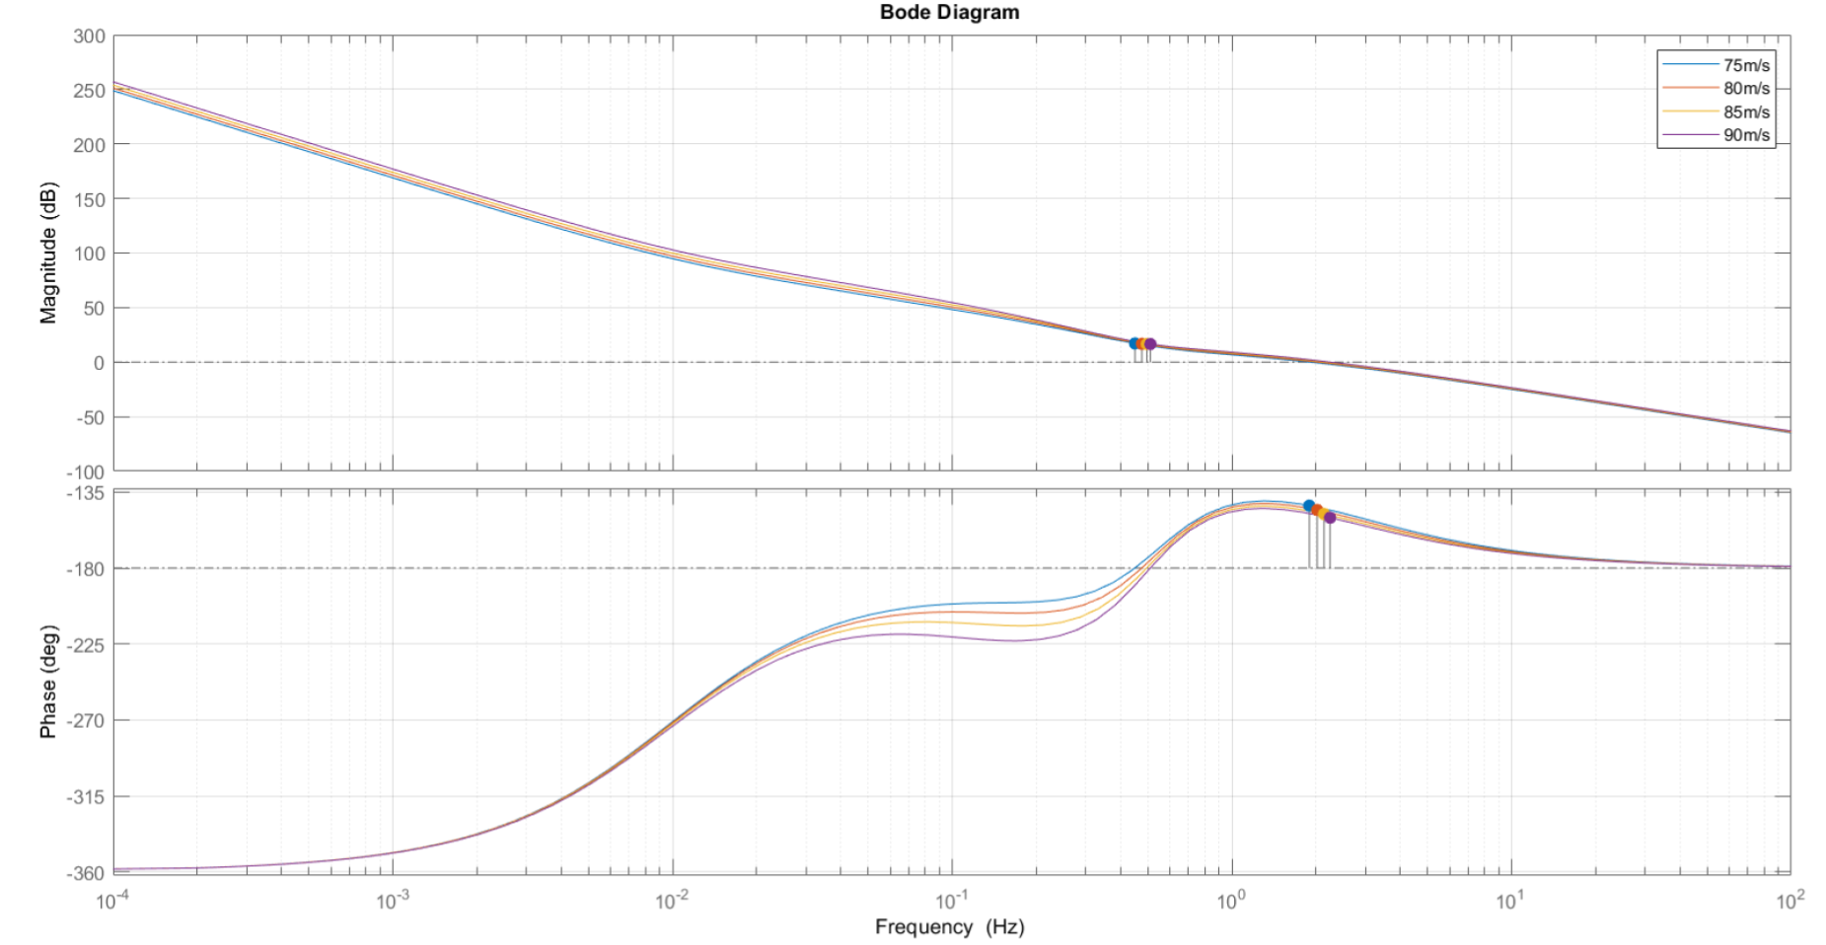
Bode diagram of L(s) at different velocity speeds
37
Alessio Russo, Carmelo Valore

Slide 38

Step response of L(s) at different velocity speeds
38
Alessio Russo, Carmelo Valore
Notes:
Senza lookahead con il regolatore di mori con gain cambiato a 0.01, le funzioni sono stabili ma ci sono oscillazioni forti già in partenza, senza feed-forward

Slide 39


Lateral controller
Lookahead varies instantly according to the velocity Vx scaled by a factor 1/k with k = 2
The feed-forward mechanism has been implemented
the value of the curvature referred to the current position of the vehicle is multiplied by the value C
39
Alessio Russo, Carmelo Valore

Slide 40
Lateral controller
Final block diagram
40
Alessio Russo, Carmelo Valore

Slide 41

Lateral error of simulation (first version with lookahead)
41
Alessio Russo, Carmelo Valore

Slide 42


Lateral controller with Lookahead (second version)
Starting from the function G(s) obtained with the addition of the error of lookahead we also defined the following regulator R(s):
That can also be seen showing that:
Gain 1.3*10^-4
Integrator
One pole in 2 Hz
Two zero in 0.01 Hz
Combining the results we define the function L(s) = R(s)*G(s)
L(s) is stable with each considered velocity
The bandwidth is around 7 Hz
The phase margin is around 35 deg
42
Alessio Russo, Carmelo Valore

Slide 43

Bode diagram of L(s) at different velocity speeds
43
Alessio Russo, Carmelo Valore
Notes:
Senza lookahead con il regolatore di mori con gain cambiato a 0.01, le funzioni sono stabili ma ci sono oscillazioni forti già in partenza, senza feed-forward

Slide 44

Step response of the system at different velocity speeds
44
Alessio Russo, Carmelo Valore
Notes:
Senza lookahead con il regolatore di mori con gain cambiato a 0.01, le funzioni sono stabili ma ci sono oscillazioni forti già in partenza, senza feed-forward

Slide 45

Lateral error with lookahead (second version)
45
Alessio Russo, Carmelo Valore
Notes:
Senza lookahead con il regolatore di mori con gain cambiato a 0.01, le funzioni sono stabili ma ci sono oscillazioni forti già in partenza, senza feed-forward

Slide 46
Meeting 7: Lateral Control
46

